Slide 1
3 ways to use local:
eliminate identical recursive calls
encapsulate 2 or more definitions
improve code clarity by giving names to intermediate values
refactoring
a fundamental technique for improving code
take a correct running program, refactor to improve structure
3 ways to use local
achieved through refactoring
or achieved when initially writing code
 | Eliminate… | Encapsulate 2… | Give names to vals
Via refactoring
While originally writing code

Slide 2
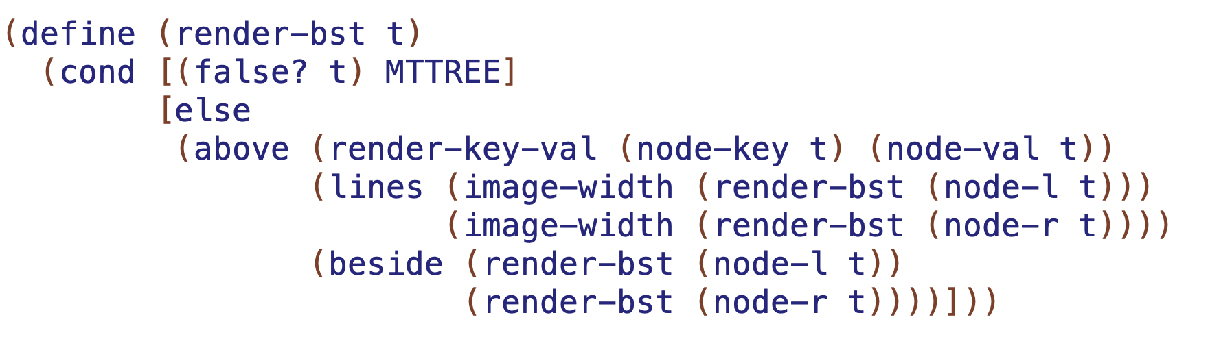
42:ily
27:wit
50:dug
14:olp
52:dug
how many times is render-bst called at each level?
…
___
…
___

Slide 3
identify duplicate recursive calls
find nearest enclosing conditional branch
add local there
move call to local definition
and replace original call with local constant name

Slide 4
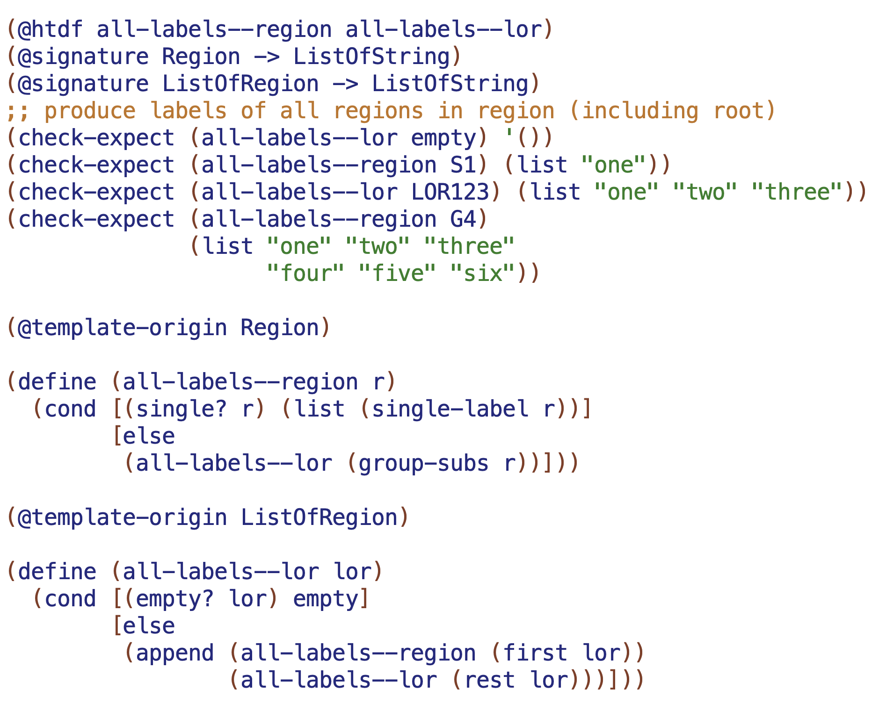

Slide 5
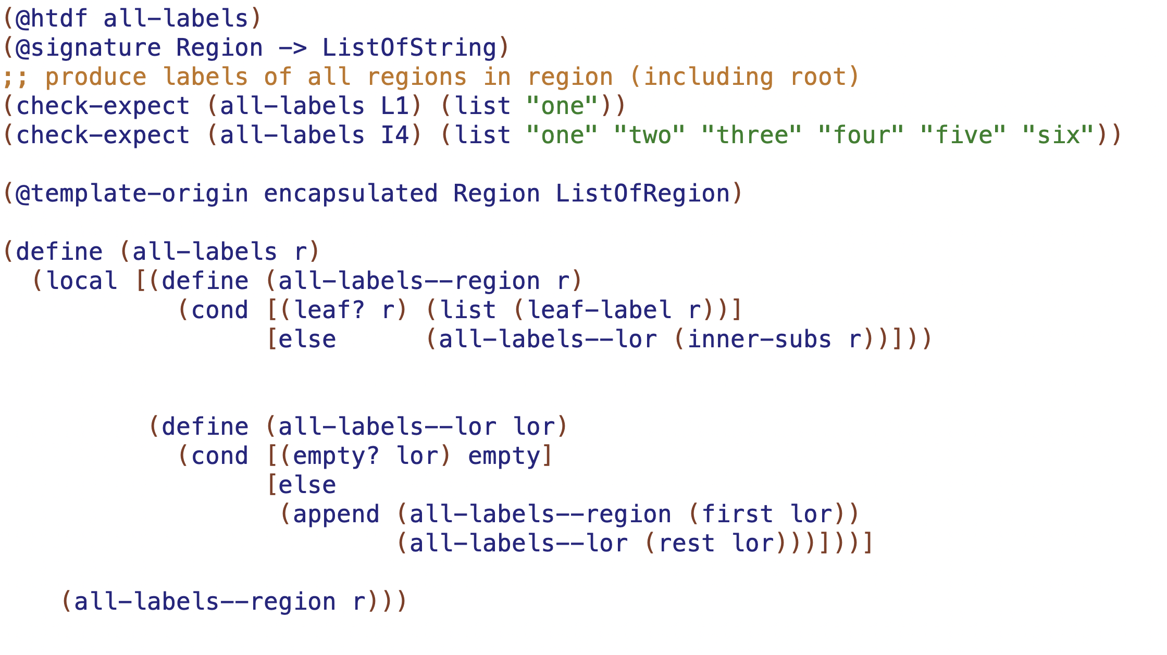

Slide 6
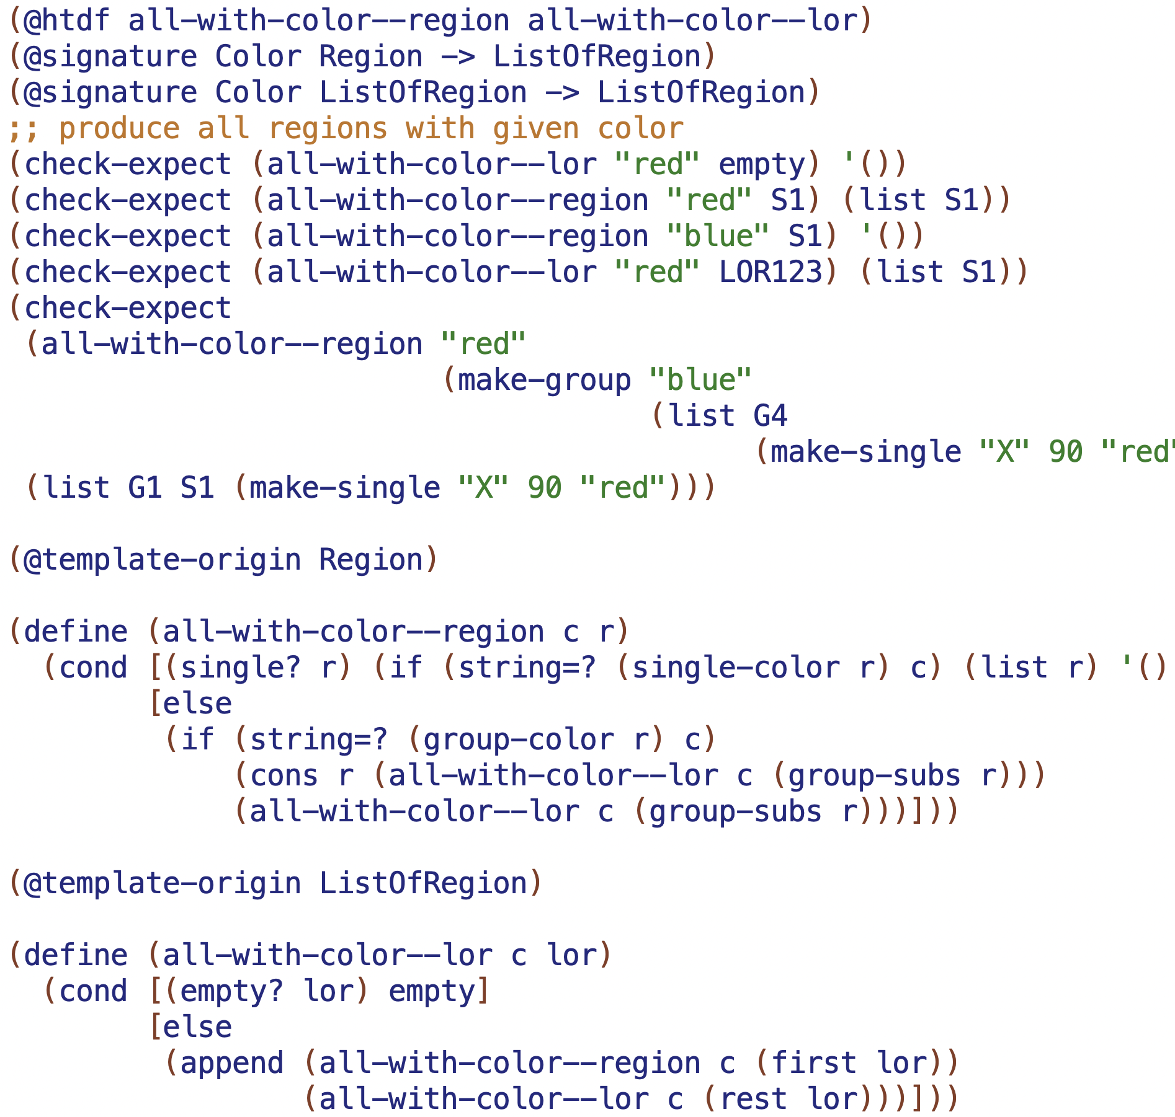

Slide 7
